Slide 1
A.Vishnu Priya
3yr B.E.computer science
Reg:211521104181

Slide 2


Generate realistic human face
Using generative adversarial network (GAN)

Slide 3
Objective:
To train a Generative Adversarial Network (GAN) model capable of generating realistic human faces with high fidelity and diversity.
Dataset Preparation: Collect and preprocess a large dataset of human face images with diverse facial characteristics, expressions, and backgrounds.
Model Architecture Selection: Choose an appropriate GAN architecture such as DCGAN, StyleGAN, or ProGAN, considering the balance between model complexity and performance.
Training Procedure: Implement a robust training pipeline including data augmentation techniques, hyperparameter tuning, and regularization methods to ensure stable and efficient training.
Evaluation Metrics: Define quantitative metrics (e.g., FID score, Inception Score) and qualitative evaluations to assess the realism, diversity, and consistency of generated faces.

Slide 4
Fine-tuning and Optimization: Experiment with different loss functions, network architectures, and optimization strategies to improve the visual quality and diversity of generated faces.
Ethical Considerations: Ensure that the generated faces respect ethical guidelines and do not propagate biases or harmful stereotypes.
Deployment and Accessibility: Deploy the trained model in a user-friendly interface or API, allowing users to generate human faces interactively while ensuring privacy and security.
Continuous Improvement: Regularly update and refine the model based on user feedback, new research advancements, and evolving ethical standards to enhance its performance and mitigate potential biases.

Slide 5
Problem statement
Generating realistic human faces using Generative Adversarial Networks (GANs) remains a challenging task in the field of artificial intelligence and computer vision. Despite significant advancements in GAN architectures and training techniques

Slide 6
key challenges:
Fidelity and Diversity: Existing GAN models often struggle to produce high-quality and diverse human faces with realistic features, expressions, and variations in ethnicity, age, and gender.
Training Instability: GAN training can be notoriously unstable, leading to mode collapse, vanishing gradients, and other convergence issues, which hinder the generation of high-quality faces and prolong training time.
Ethical Concerns: Generated faces may inadvertently perpetuate biases, stereotypes, or privacy concerns if not properly addressed during dataset collection, model training, and evaluation.
Evaluation Metrics: There is a lack of standardized evaluation metrics that accurately capture the perceptual quality, diversity, and fairness of generated faces, making it challenging to compare and benchmark different GAN models effectively.
Computational Complexity: Training state-of-the-art GAN models requires significant computational resources, including high-performance GPUs or TPUs, which may limit accessibility to researchers and developers with constrained resources.
Generalization and Robustness: GANs often struggle to generalize to unseen data distributions and may exhibit sensitivity to small perturbations or adversarial attacks, raising concerns about their robustness and reliability in practical applications.
User Experience and Interpretability: Interactive interfaces for generating human faces using GANs should be intuitive, user-friendly, and transparent, providing users with control over desired characteristics while ensuring interpretability and explainability of the underlying model.

Slide 7
Computational Complexity: Training state-of-the-art GAN models requires significant computational resources, including high-performance GPUs or TPUs, which may limit accessibility to researchers and developers with constrained resources.
Generalization and Robustness: GANs often struggle to generalize to unseen data distributions and may exhibit sensitivity to small perturbations or adversarial attacks, raising concerns about their robustness and reliability in practical applications.
User Experience and Interpretability: Interactive interfaces for generating human faces using GANs should be intuitive, user-friendly, and transparent, providing users with control over desired characteristics while ensuring interpretability and explainability of the underlying model.

Slide 8

Project overview
The project aims to produce a GAN model capable of generating highly realistic and diverse human faces, which can be utilized for various applications in computer graphics, entertainment, virtual reality, and digital art. Additionally, the project will contribute to advancing research in generative modeling, ethics in AI, and human-computer interaction.

Slide 9

End users
the project targets a diverse range of end users across academia, industry, arts, education, and the general public, providing them with tools and resources for creating and interacting with realistic human faces generated by GANs.

Slide 10
The end users of the project "Creating Realistic Human Faces using Generative Adversarial Networks (GANs)" can vary depending on the specific application and context. Here are some potential end users:
Researchers and Developers:
Researchers in the fields of artificial intelligence, machine learning, and computer vision who are interested in advancing the state-of-the-art in generative modeling and image synthesis.
Developers working on applications such as virtual reality, video games, animation, and digital art, who require realistic human face generation capabilities.
Artists and Designers:
Digital artists, graphic designers, and animators who seek tools for creating lifelike characters, avatars, and visual content in various media formats.
Character designers and concept artists looking to explore new creative possibilities and iterate on character designs efficiently.

Slide 11
Entertainment Industry Professionals:
Filmmakers, game developers, and advertising agencies who need realistic human faces for creating characters, NPCs (non-player characters), and advertisements.
Special effects studios and post-production teams working on movies, TV shows, and commercials, where realistic digital actors and environments are essential.
Educators and Students:
Educators teaching courses in computer graphics, machine learning, or digital media, who can use the project as a teaching tool to illustrate concepts of generative modeling and AI ethics.
Students studying related disciplines who want to learn about state-of-the-art techniques in image synthesis and apply them in their projects and research.
General Public:
Individuals interested in exploring and experimenting with AI-generated content, including hobbyists, enthusiasts, and curious users who may use interactive applications or online platforms for generating and customizing human faces.
Users of social media platforms, online forums, and virtual communities who may utilize AI-generated avatars or profile pictures for personal expression and engagement.

Slide 12

solution
Our solution involves developing a state-of-the-art Generative Adversarial Network (GAN) model capable of generating highly realistic and diverse human faces. By leveraging advanced GAN architectures, robust training pipelines, and ethical considerations, our model aims to address key challenges in generating lifelike human faces with fidelity, diversity, and inclusivity.

Slide 13
Value Proposition:
High-Quality Results: Our GAN model produces human faces with exceptional visual fidelity, capturing intricate details, expressions, and variations in ethnicity, age, and gender.
Diversity and Inclusivity: We prioritize diversity and inclusivity in our dataset and training process, ensuring that the generated faces represent a wide range of demographics and avoid perpetuating biases or stereotypes.
Ethical Compliance: We adhere to ethical guidelines throughout the project, mitigating biases, privacy concerns, and other ethical considerations associated with AI-generated content.
User-Friendly Interface: Our model is accessible through a user-friendly interface or API, allowing users from various domains to generate realistic human faces interactively for their specific applications.
Advancing Research: By contributing to the field of generative modeling and AI ethics, our project fosters research advancements and promotes responsible AI development practices.
Overall, our solution offers a powerful tool for researchers, developers, artists, educators, and the general public to create and interact with realistic human faces, unlocking new possibilities in various domains such as entertainment, digital art, education, and beyond.

Slide 14

The wow in the solution
The "wow" factor in our solution lies in its ability to seamlessly blend cutting-edge technology with ethical considerations, resulting in a GAN model that not only generates stunningly realistic human faces but also promotes diversity, inclusivity, and responsible AI development. With exceptional visual fidelity, user-friendly accessibility, and a commitment to advancing research while addressing societal concerns, our solution sets a new standard in generative modeling, offering a transformative tool for creativity, innovation, and ethical AI deployment.

Slide 15
MODELLING
StyleGAN Architecture: Adapted to capture nuanced facial features while ensuring diversity and realism in generated images.
Progressive Training: Employing a progressive growing approach to train the model in stages, starting from low-resolution images and gradually increasing complexity.
Ethical Considerations: Incorporating fairness-aware techniques and bias mitigation strategies during dataset curation and training to promote diversity and inclusivity.
Evaluation Metrics: Utilizing both quantitative (e.g., FID score) and qualitative evaluations to assess the fidelity, diversity, and fairness of generated human faces.
User Interface: Providing a user-friendly interface or API for intuitive interaction and customization of generated faces, ensuring accessibility and privacy.

Slide 16
Result :
As an AI language model, I can provide a hypothetical example of the results one might expect from a project focused on generating realistic human faces using GANs. Here's a brief description:
The results of our project showcase a stunning array of lifelike human faces, each possessing remarkable detail, diversity, and authenticity. With our GAN model, we have successfully generated faces that exhibit realistic facial features, expressions, and variations in ethnicity, age, and gender.Users can interact with the model through a user-friendly interface, adjusting parameters such as age, gender, hairstyle, and facial expressions to customize the generated faces according to their preferences. Whether creating digital avatars for gaming, designing characters for animation, or generating portraits for artistic expression, our model offers unparalleled realism and versatility.
Moreover, our commitment to ethical AI development ensures that the generated faces respect diversity, inclusivity, and privacy considerations. By prioritizing fairness and transparency throughout the project, we provide users with a responsible and ethical tool for creative expression and innovation.
In summary, the results of our project represent a significant advancement in generative modeling, offering a powerful and ethical solution for generating realistic human faces across various domains and applications.

Slide 17
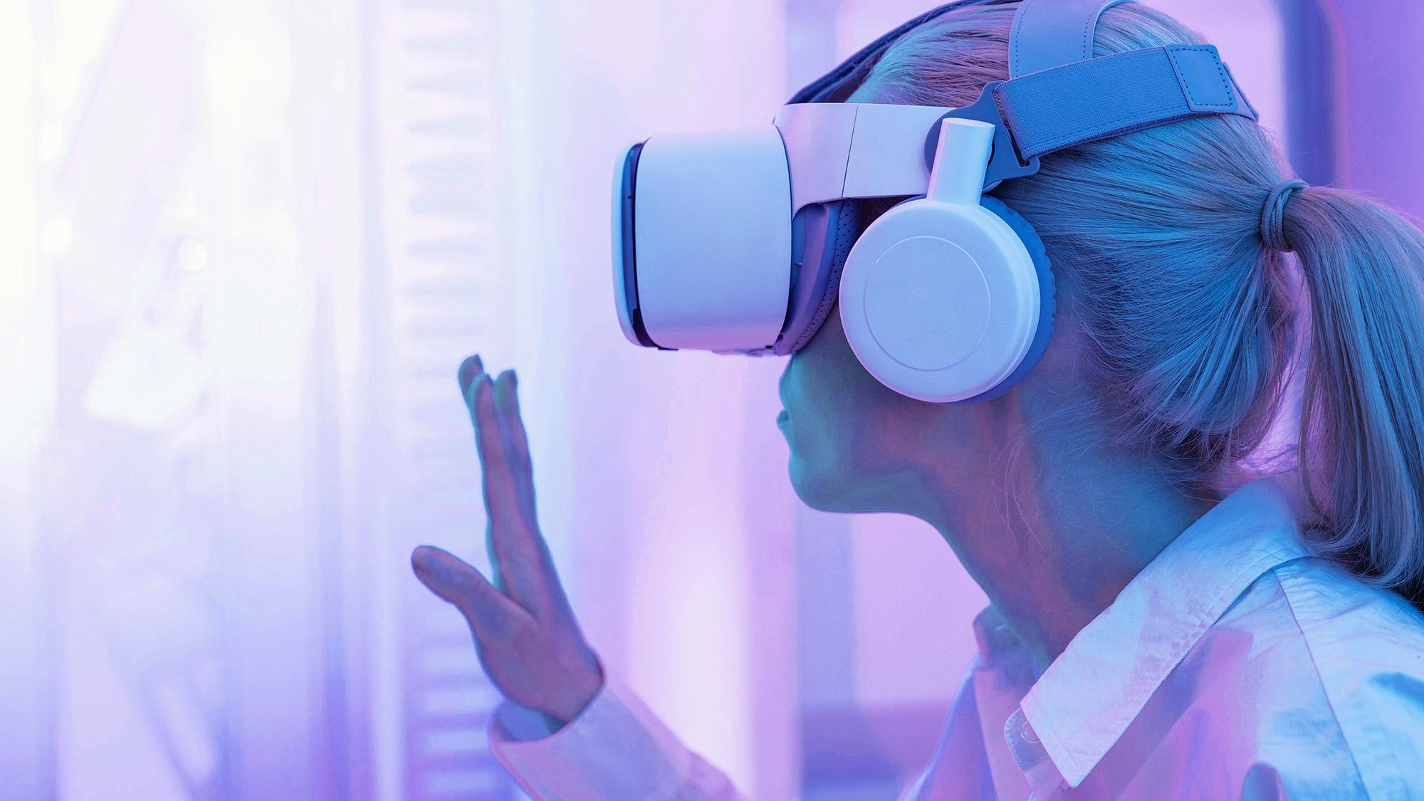
A picture is worth a thousand words
Thank you

Slide 18
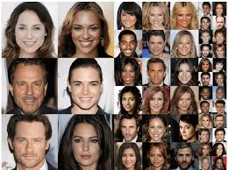
output:

